Slide 1
Spring Activity Week 28th of April – 2nd of May

Slide 2
Objectives
Reinforce Computation Training for earlier Activity Weeks
Build Collaboration within Cohort (Group Activities)
Data Management Plan Training

Slide 3
Activity Week Schedule

Slide 4
Hackathon

Slide 5
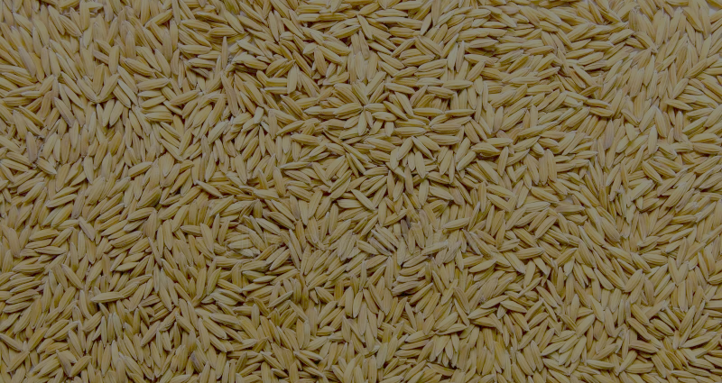
Rice Seeds
Vietnam is the world’s 3rd largest producer of rice - Annual exports of $2.95 billion from 6.61 million tonnes in 2013.
Verification Centres inspect rice seed to confirm varietal identity to ensure consistency, quality assurance, improve disease and pest management and comply with export standards

Slide 6
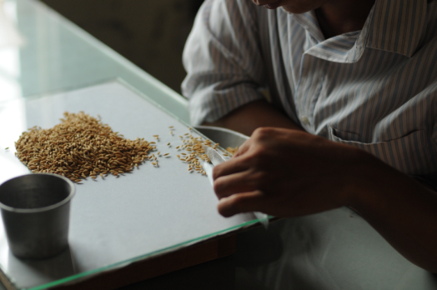
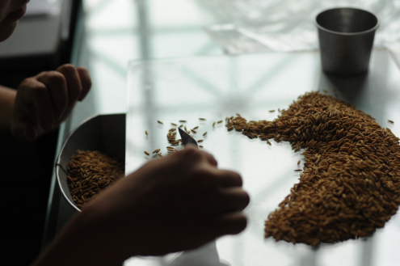
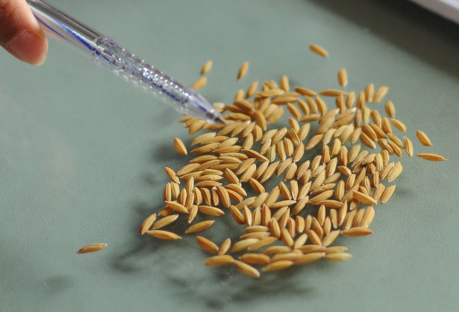
Conventional Inspection
Manual, labour intensive process
1,000’s of species
Limited sampling; 200 seeds per bag

Slide 7

Dataset
8,640 rice seed kernels: 90 rice seed species and 96 kernels per
Imaging systems:
Visible - Near Infrared (VIS/NIR) Hyperspectral Imaging Device System (~385nm - ~1000nm) consisting of a Specim V10E Imaging Spectrograph and Hamamatsu ORCA-05G CCD camera.
RGB - Fujifilm X-M1 with a 35mm/F2.0, ISO 400.
https://doi.org/10.5281/zenodo.3241922
Dataset already on Maxwell; see repository for full path
Partial Dataset (~1GB): https://tinyurl.com/hsi-partial
Research Article: https://doi.org/10.1109/ACCESS.2020.2969847

Slide 8
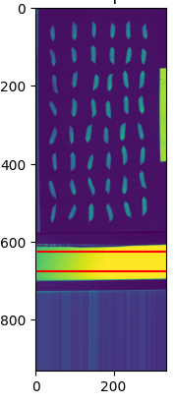
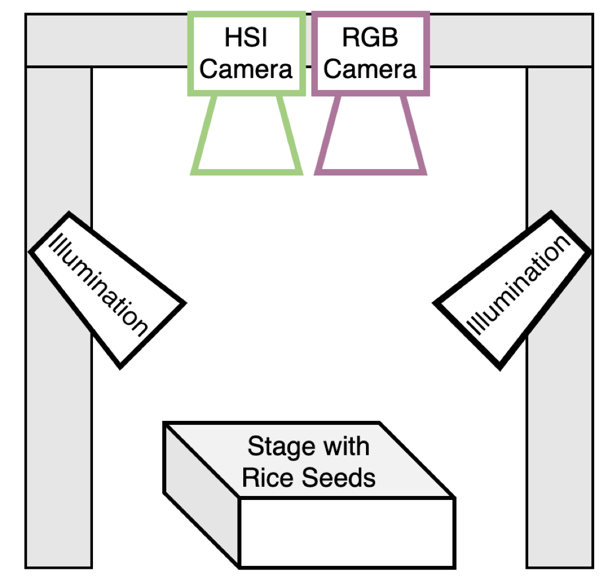
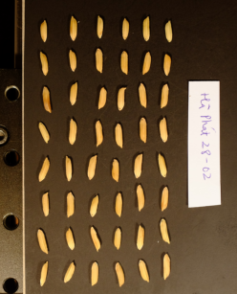
Automatic Inspection (Computer Vision)

Slide 9
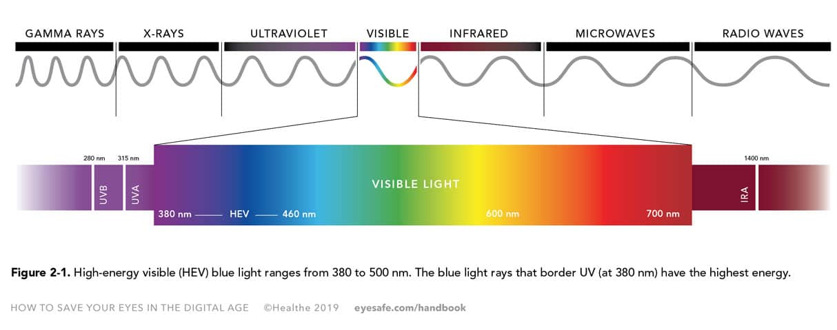
Spectrum

Slide 10
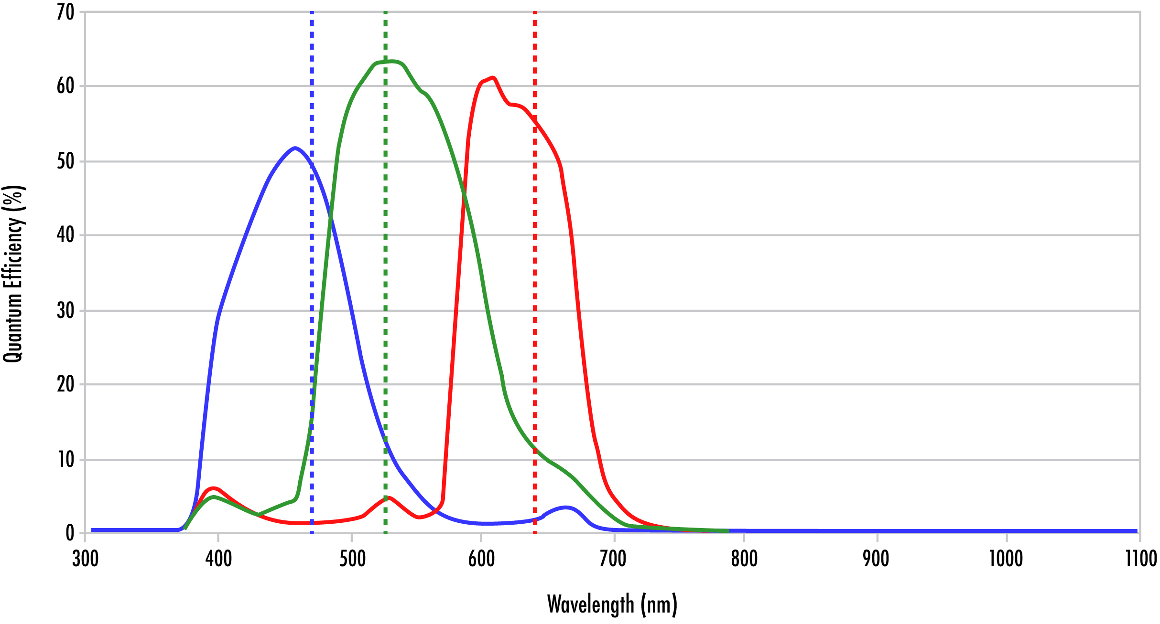
RGB

Slide 11
RGB vs HSI

Slide 12
Push Broom Camera

Slide 13
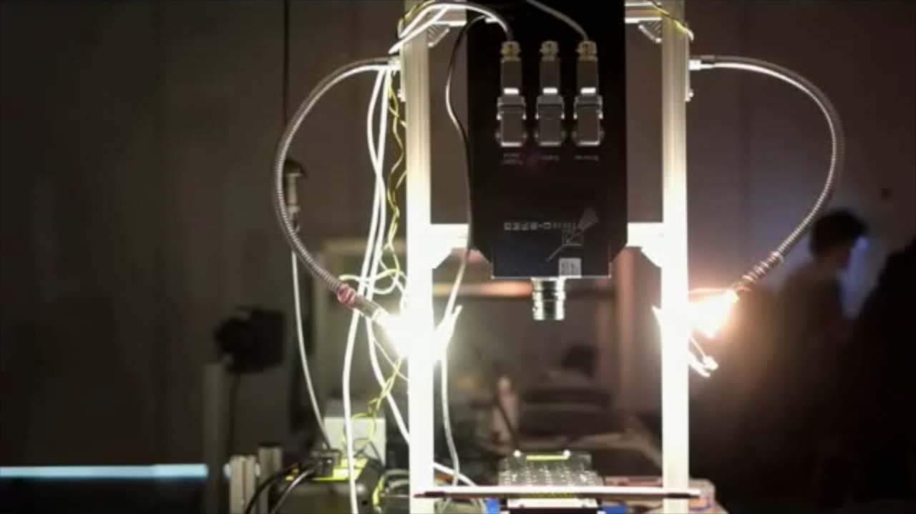
Automatic Inspection

Slide 14
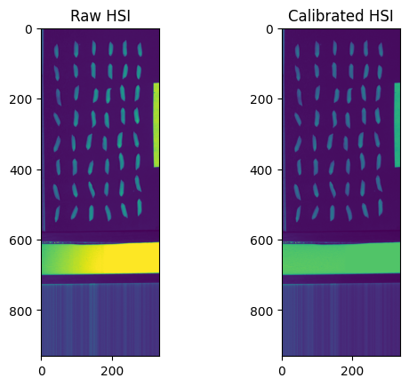
HSI Calibration
Imbalanced illumination
Correct sensor effects

Slide 15

HSI Calibration
100% reflective
Spectralon tile
Lens cap applied
for black

Slide 16
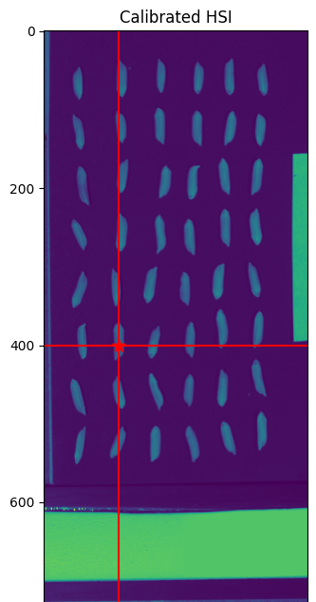
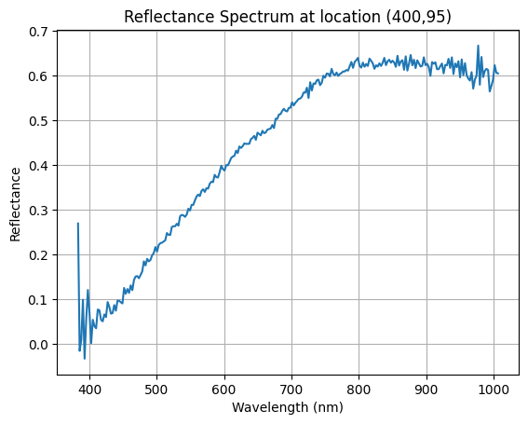
Example Spectra

Slide 17

Dataset and Simple Notebook
https://github.com/SUSTAIN-CDT/rice-hsi-hackathon-2025
Partial Dataset (~1GB): https://tinyurl.com/hsi-partial

Slide 18
Teams
Team A:
Aura
Lauren
Alisa
Jack
Team B:
Athinoulla
Dominik
James
Villanelle
Could you please come up with a name for your team?

Slide 19
Objectives
Explore the Dataset: Investigate the hyperspectral data to identify interesting patterns
Develop a Model: Create an innovative approach to analyze or classify the rice seed varieties
Visualize Results: Generate some visualizations that demonstrate your findings
Prepare a Presentation: Document your methodology and results for Friday's presentation

Slide 20
Submission Requirements
Code Repository: Well-documented code for your analysis and models
Results Summary: Key findings and visualizations
Presentation: A 15-minute presentation explaining your approach and discoveries
Technical Documentation: Methods, challenges, and potential applications

Slide 21
Evaluation Criteria
Innovation: Originality of approach and techniques
Technical Merit: Effectiveness and sophistication of models/algorithms
Insights: Quality and relevance of discoveries from the data
Presentation: Clarity and engagement of the final presentation

Slide 22

Good Luck

